Slide 1



Consumer and user research
Make smart decisions fast!

Slide 2

We can help
We study opinions, needs, behaviours and preferences of people,
so that you can create outstanding products and advertising
Products
Identify demand. Check and prioritize ideas. Choose the best option for implementation. Evaluate returns.
Advertising
Find creative ideas and promotion channels. Choose the best message or design. Measure effectiveness of campaigns.
For researchers, marketing or product teams, and management.

Slide 3
Power of simple solutions
You have a question – we have the answer.
We eliminate doubts, so you can be confident in the decisions you make
Understand and create
Check your ideas and know your TA
Customer Voice
High-quality research online
Fastuna
Self-help on standard tasks in 24 hours
Quick Surveys
Complete specific tasks with our help
Brand Tracker
Monitoring of brand value on the market
Digital Audit
Verification of advertising campaigns
Digital Lift
Measure effectiveness of the advertising campaigns
Measure the effectiveness

Slide 4

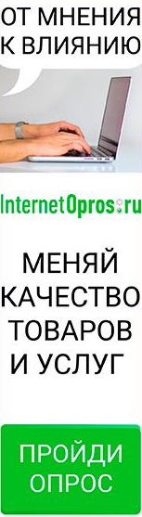
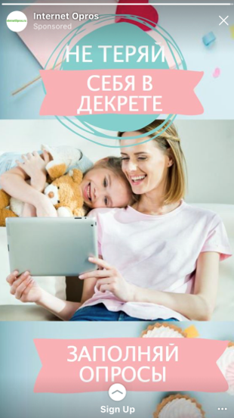
Listening to people is priceless
If a company is not talking to people, it can’t grasp the reality of their needs and motivations
550 000
active panel members
+ 80 000 new panelists per month.
Panelists are involved because they find it ineresting. They receive only a small reward.
Video about their motivations.
We know about their income, work, family, pets, health, cars, consumption.
We track the quality of our panel. We screen out those who break our rules. We make nice surveys that people enjoy completing.
Recruit through the banners in social networks (expensive, but high quality)

Slide 5

Understand and design

Slide 6
Customer Voice
Qualitative research online. We help you listen to your clients and understand them.
If you want to understand the needs of people, how they articualte them and how they perceive products and ads.
Ask questions in a right way. Our moderators can establish rapport with people to get honest views even on sensitive topics.
You can join. The clients can observe, talk to people themselves or just receive the final report.
In just 3 days. We have everything: moderators, respondents, platform. That’s why it’s so quick.
Reports. We write Essence reports — 5-min summary, and produce analytical reports in PPT.
In-depth interviews
on Skype
Communities
on our own platform
Chats
via messengers 1-2-1

Slide 7
Test your ideas
and ask TA

Slide 8

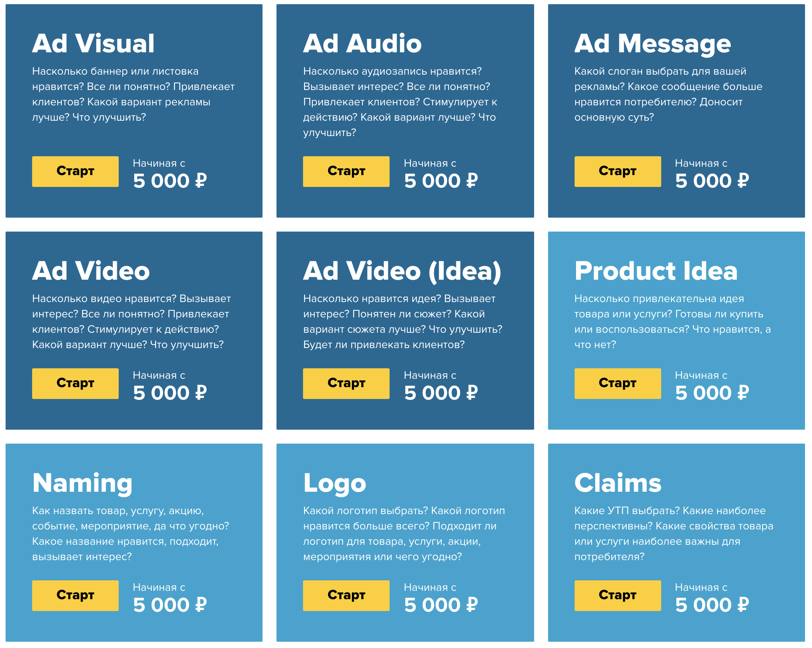
Fastuna
Solve standard tasks independently in 24 hours
Launch in 5 minutes
Tested solutions for standard tasks. Choose what you need, identify TA, upload marketing materials and initiate a project.
Simple online report in 24 hours
You don’t need any specialist knowledge. All members of your team can understand the report.
All examples can be found on
www.fastuna.ru

Slide 9
Quick Surveys
Quick answers on specific questions in simple words
Small, but important questions
Тhere are a lot of questions like that. They are different, unique. And they come up on the spot.
Quick answers
Help to make good business decisions in time
Give us a task
We will call you to clarify everything in 2 hours. Design and agree a small questionnaire. Survey your TA.
You will get
Data
Necessary for decision-making.
Debrief
We will call you to discuss the results.
Essence (optional, + 24 hours)
Short analytical report, if you need to share the results.
Example, another one and more.

Slide 10
Measure effectiveness

Slide 11
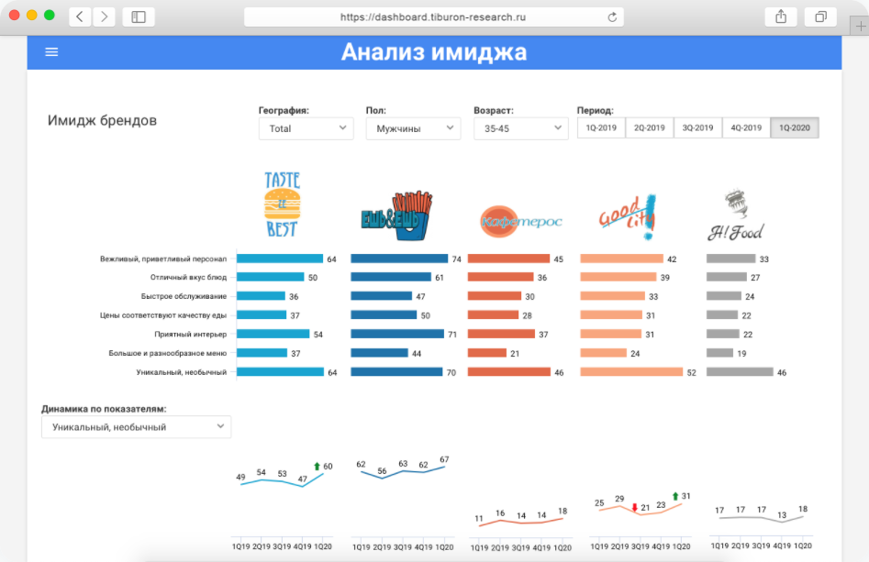
Brand Tracker
Continuous research to measure brand value and advertising performance in the market
Dashboards instead of PPT
Export to PPT is also available ;). Only key data necessary to make a decision. All results are in one place straight after data collection.
Different levels of access
Dashboard KPIs segmented to client needs. Directors, managers and regional team members can see the reports relevant for them.
Dashboard example

Slide 12
Digital Audit
Verification of advertising campaign in 24 hours
Total Reach, Reach TA, Average Frequency. How many people were reached by the advertising campaign? With what frequency? How is this split by channel?
Profiling. Who are the people who viewed advertising? Profile of audience and consumption patterns.
Targeting Accuracy. How accurate was the targeting?
Share of your Target Audience amongst all those who interacted with advertisement.
Incremental Reach TA. Which digital advertising channels work better? In terms of incremental reach and ability to acquire new audiences.
Example of a report
Interacted with advertising campaign
TA
Mail.ru
YouTube

Slide 13
Digital Lift
Measuring effectiveness of digital advertising campaigns
Brand KPIs
Awareness, purchase intent, brand image.
Diagnostic
How memorable the design is, brand awareness and concept understanding.
Estimate the idea with KPIs
Attractiveness, advantages/disadvantages, uniqueness, relevance.
Report example
Effect from AC
KPI
Didn’t view the ad
Viewed the ad

Slide 14
Our company

Slide 15



























Our clients
Big business
Agencies

Slide 16
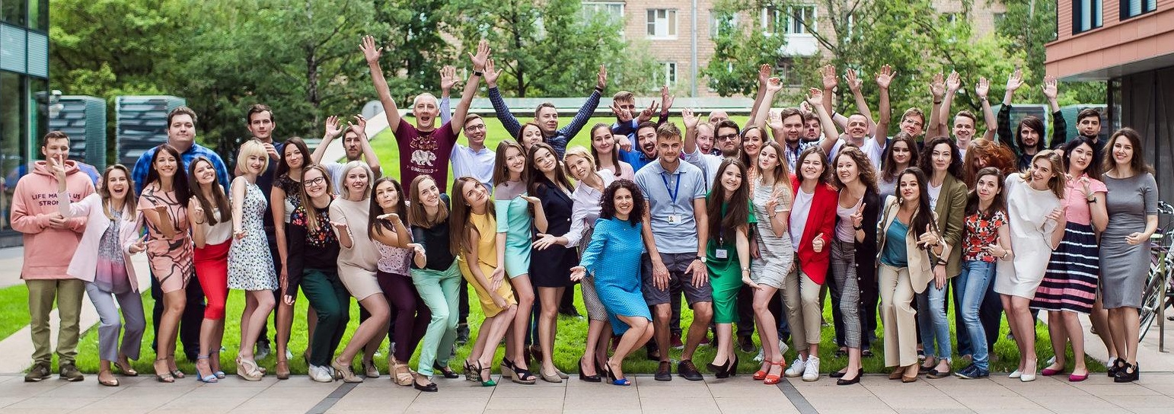
Our team

Slide 17

Email or call
www.tiburon-research.ru
client@tiburon-research.ru
+7 495 648 7820

